Slide 1
Practice
https://www.w3resource.com/c-programming-exercises/array/index.php
Write a program in C to read n number of values in an array and display them in reverse order.
Write a program in C to find the sum of all elements of the array.
Write a program in C to copy the elements of one array into another array.
Write a program in C to count the total number of duplicate elements in an array.
Write a c program to sort an array
Write a program in C to find the maximum and minimum elements in an array.

Slide 2
for (i = 0; i < n; i++) {
for (j = i + 1; j < n; j++) {
if (arr[i] == arr[j]) {
ctr++;
break;
}
}
for(i=0;i<n; i++) {
for(k=0;k<n-1;k++) {
if(arr[k]<=arr[k+1]) {
j=arr[k+1];
arr[k+1]=arr[k];
arr[k]=j;
}
}
}
mx = arr1[0];
mn = arr1[0];
for(i=1; i<n; i++) {
if(arr1[i]>mx) {
mx = arr1[i];
}
if(arr1[i]<mn) {
mn = arr1[i];
}
}

Slide 3
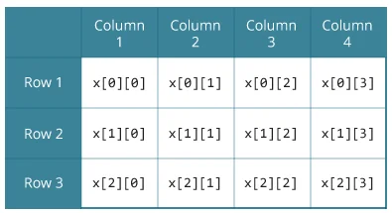
Mutlidimensional Array
float x[3][4];

Slide 4
How to Initialize?
// Different ways to initialize two-dimensional array
int c[2][3] = {{1, 3, 0}, {-1, 5, 9}};
int c[][3] = {{1, 3, 0}, {-1, 5, 9}};
int c[2][3] = {1, 3, 0, -1, 5, 9};

Slide 5
Temp of Different Cities
 | CITY 1 | CITY 2
Day 1 | 37 | 28
Day 2 | 40 | 25
Day 3 | 38 | 23
Day 4 | 36.5 | 21
Day 5 | 23 | 27
Day 6 | 32 | 26
Day 7 | 31 | 30

Slide 6
// C program to store temperature of two cities of a week and display it.
#include <stdio.h>
const int CITY = 2;
const int WEEK = 7;
int main()
{
int temperature[CITY][WEEK];
// Using nested loop to store values in a 2d array
for (int i = 0; i < CITY; ++i)
{
for (int j = 0; j < WEEK; ++j)
{
printf("City %d, Day %d: ", i + 1, j + 1);
scanf("%d", &temperature[i][j]);
}
}
printf("\nDisplaying values: \n\n");
// Using nested loop to display vlues of a 2d array
for (int i = 0; i < CITY; ++i)
{
for (int j = 0; j < WEEK; ++j)
{
printf("City %d, Day %d = %d\n", i + 1, j + 1, temperature[i][j]);
}
}
return 0;
}

Slide 7
Find out on what day City 1 and 2 had max and min temp?

Slide 8
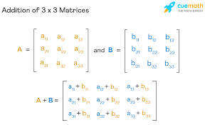
A matrix can only be added to (or subtracted from) another matrix if the two matrices have the same dimensions

Slide 9
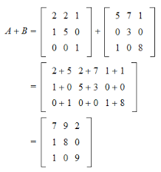
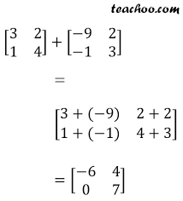
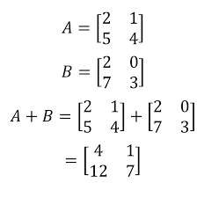

Slide 10
SAMPLE OUTPUT
Enter the number of rows (between 1 and 100): 2
Enter the number of columns (between 1 and 100): 3
Enter elements of 1st matrix:
Enter element a11: 2
Enter element a12: 3
Enter element a13: 4
Enter element a21: 5
Enter element a22: 2
Enter element a23: 3
Enter elements of 2nd matrix:
Enter element b11: -4
Enter element b12: 5
Enter element b13: 3
Enter element b21: 5
Enter element b22: 6
Enter element b23: 3
Sum of two matrices:
-2 8 7
10 8 6

Slide 11
CODE
// adding two matrices
for (i = 0; i < r; ++i)
for (j = 0; j < c; ++j) {
sum[i][j] = a[i][j] + b[i][j];
}
// printing the result
printf("\nSum of two matrices: \n");
for (i = 0; i < r; ++i)
for (j = 0; j < c; ++j) {
printf("%d ", sum[i][j]);
if (j == c - 1) {
printf("\n\n");
}
}

Slide 12
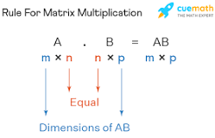
The product of two matrices A and B is defined if the number of columns of A is equal to the number of rows of B

Slide 13
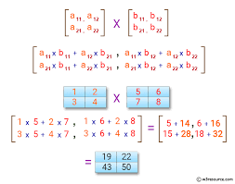
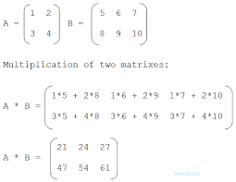

Slide 14
CODE
// Multiplying first and second matrices and storing it in result
for (int i = 0; i < r1; ++i) {
for (int j = 0; j < c2; ++j) {
for (int k = 0; k < c1; ++k) {
result[i][j] += first[i][k] * second[k][j];
}
}
}

